Slide 1
Finding
Neighborhood
Capstone Project
By Rohit Kumar Singh

Slide 2
Methodology
Machine Learning(k-means clustering)
2. Exploratory Data Analysis
3. Inferential Analysis

Slide 3
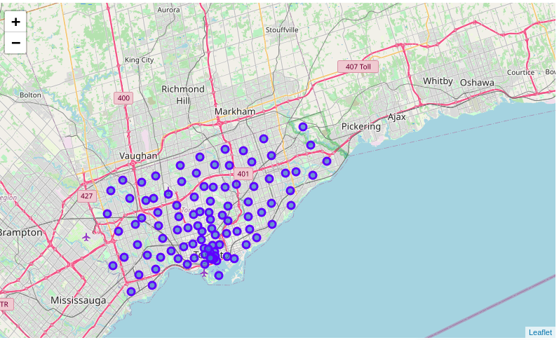

Slide 4
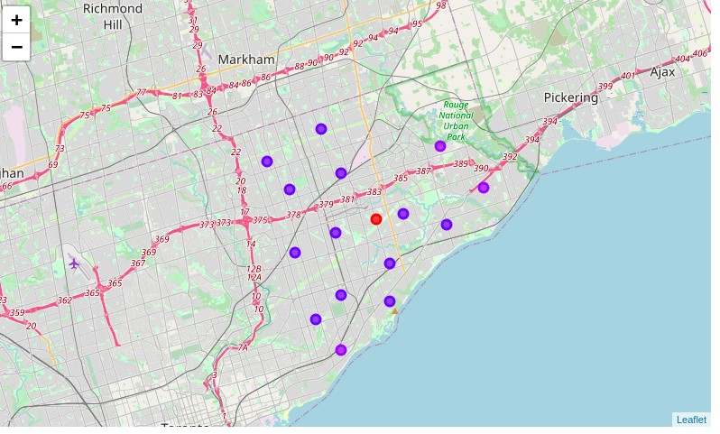

Slide 5
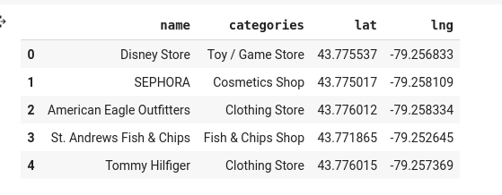
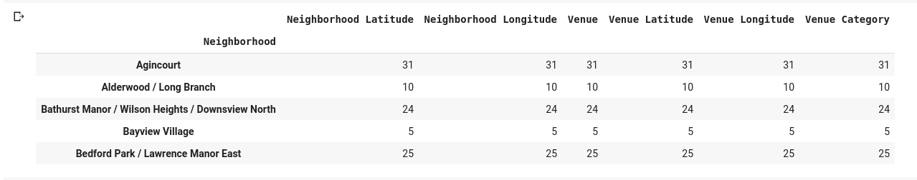
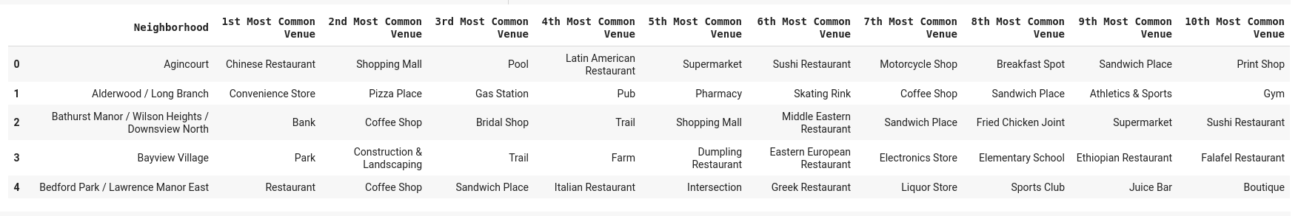
Datasets

Slide 6
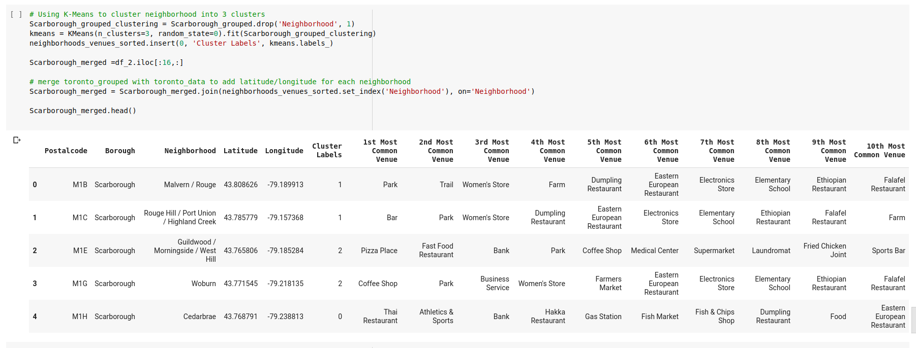
Clustering

Slide 7
Result (selected neighbourhoods)

Slide 8
THANK YOU

